Slide 1
CUSTOMER SEGMENTATION

Slide 2
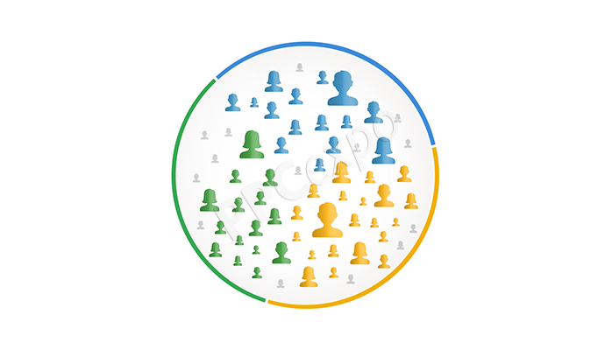
DEFINITION
Customer segmentation is the practice of dividing the companies customers into a groups that reflects similarity among the customers in each group is called customer segmentation.

Slide 3
Most Common Ways
Demographic information :-Age ,gender ,familial & marital status,income ,education & occupation.
Geographical information:-Customers city, state or even country of residence.
Psychographical :-Social class, lifestyle , personality traits.
Behavioral data:-Spending & consumption habits, product or service usage,& desired benefits.

Slide 4
ADVANTAGES
Determine appropriate product pricing.
Develop customized marketing campaigns.
Design an optimal distribution strategy.
Choose specific product features for deployment.
Prioritize new product development efforts.

Slide 5
DATA PRE-PROCESSING
Importing libraries.
Importing dataset
Missing values detection & treatment.
Outliers detection & treatment.

Slide 6
ALGORITHM
K Means Clustering Algorithm
K-Means Clustering is an unsupervised learning algorithm that is used to solve the clustering problems in machine learning or data science. In this topic, we will learn what is K-means clustering algorithm, how the algorithm works, along with the Python implementation of k-means clustering.

Slide 7
STEPS FOR ALGORITHM
Specify number of clusters K.
Initialize centroids by first shuffling the dataset and then randomly selecting K data points for the centroids without replacement.
Keep iterating until there is no change to the centroids. i.e assignment of data points to clusters isn’t changing.

Slide 8
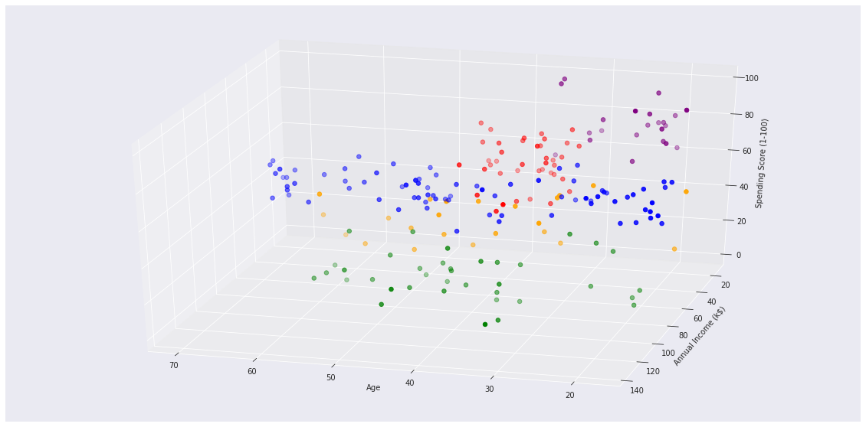
OUTPUT

Slide 9
THANK YOU

